Slide 1
GBIF/SCAN Integration

Slide 2
What is GBIF?

Slide 3
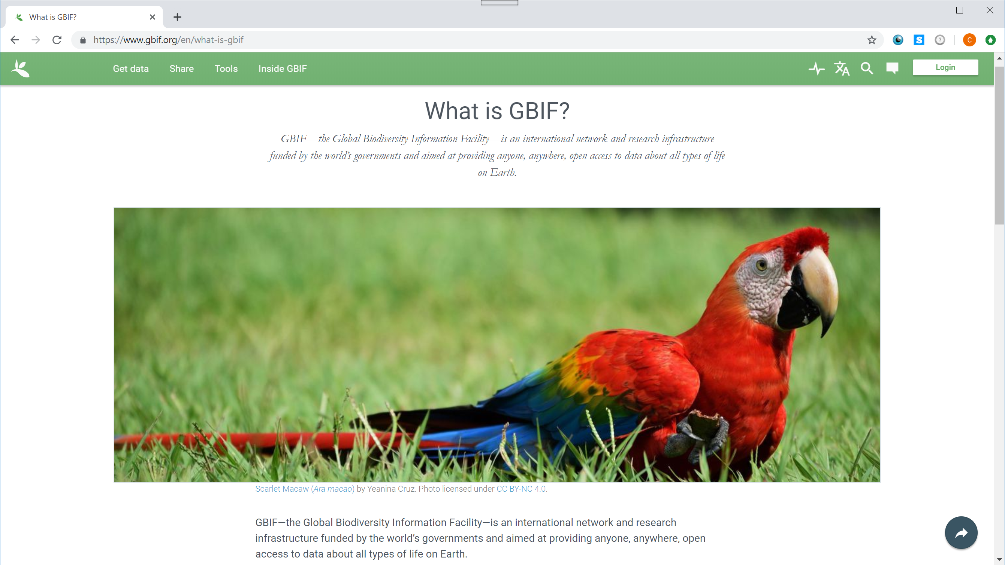

Slide 4
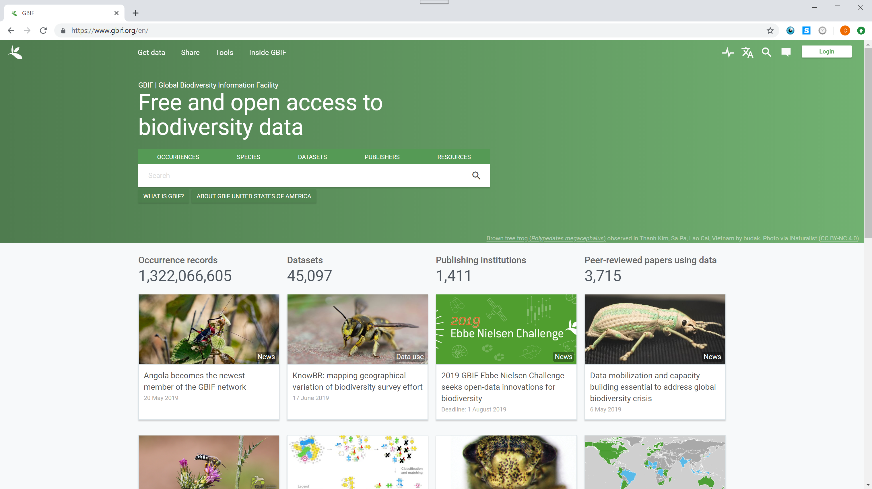

Slide 5
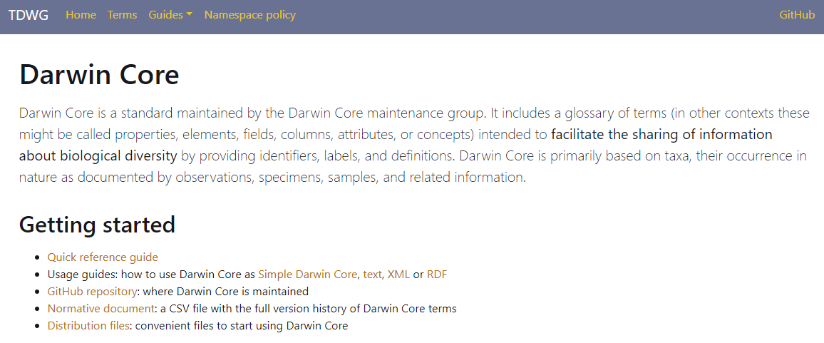
“The GBIF network draws all these sources together through the use of the Darwin Core standard, which forms the basis of GBIF.org’s index of hundreds of millions of species occurrence records.”

Slide 6
How to get VectorBase data onto GBIF?

Slide 7
Use an intermediary!

Slide 8
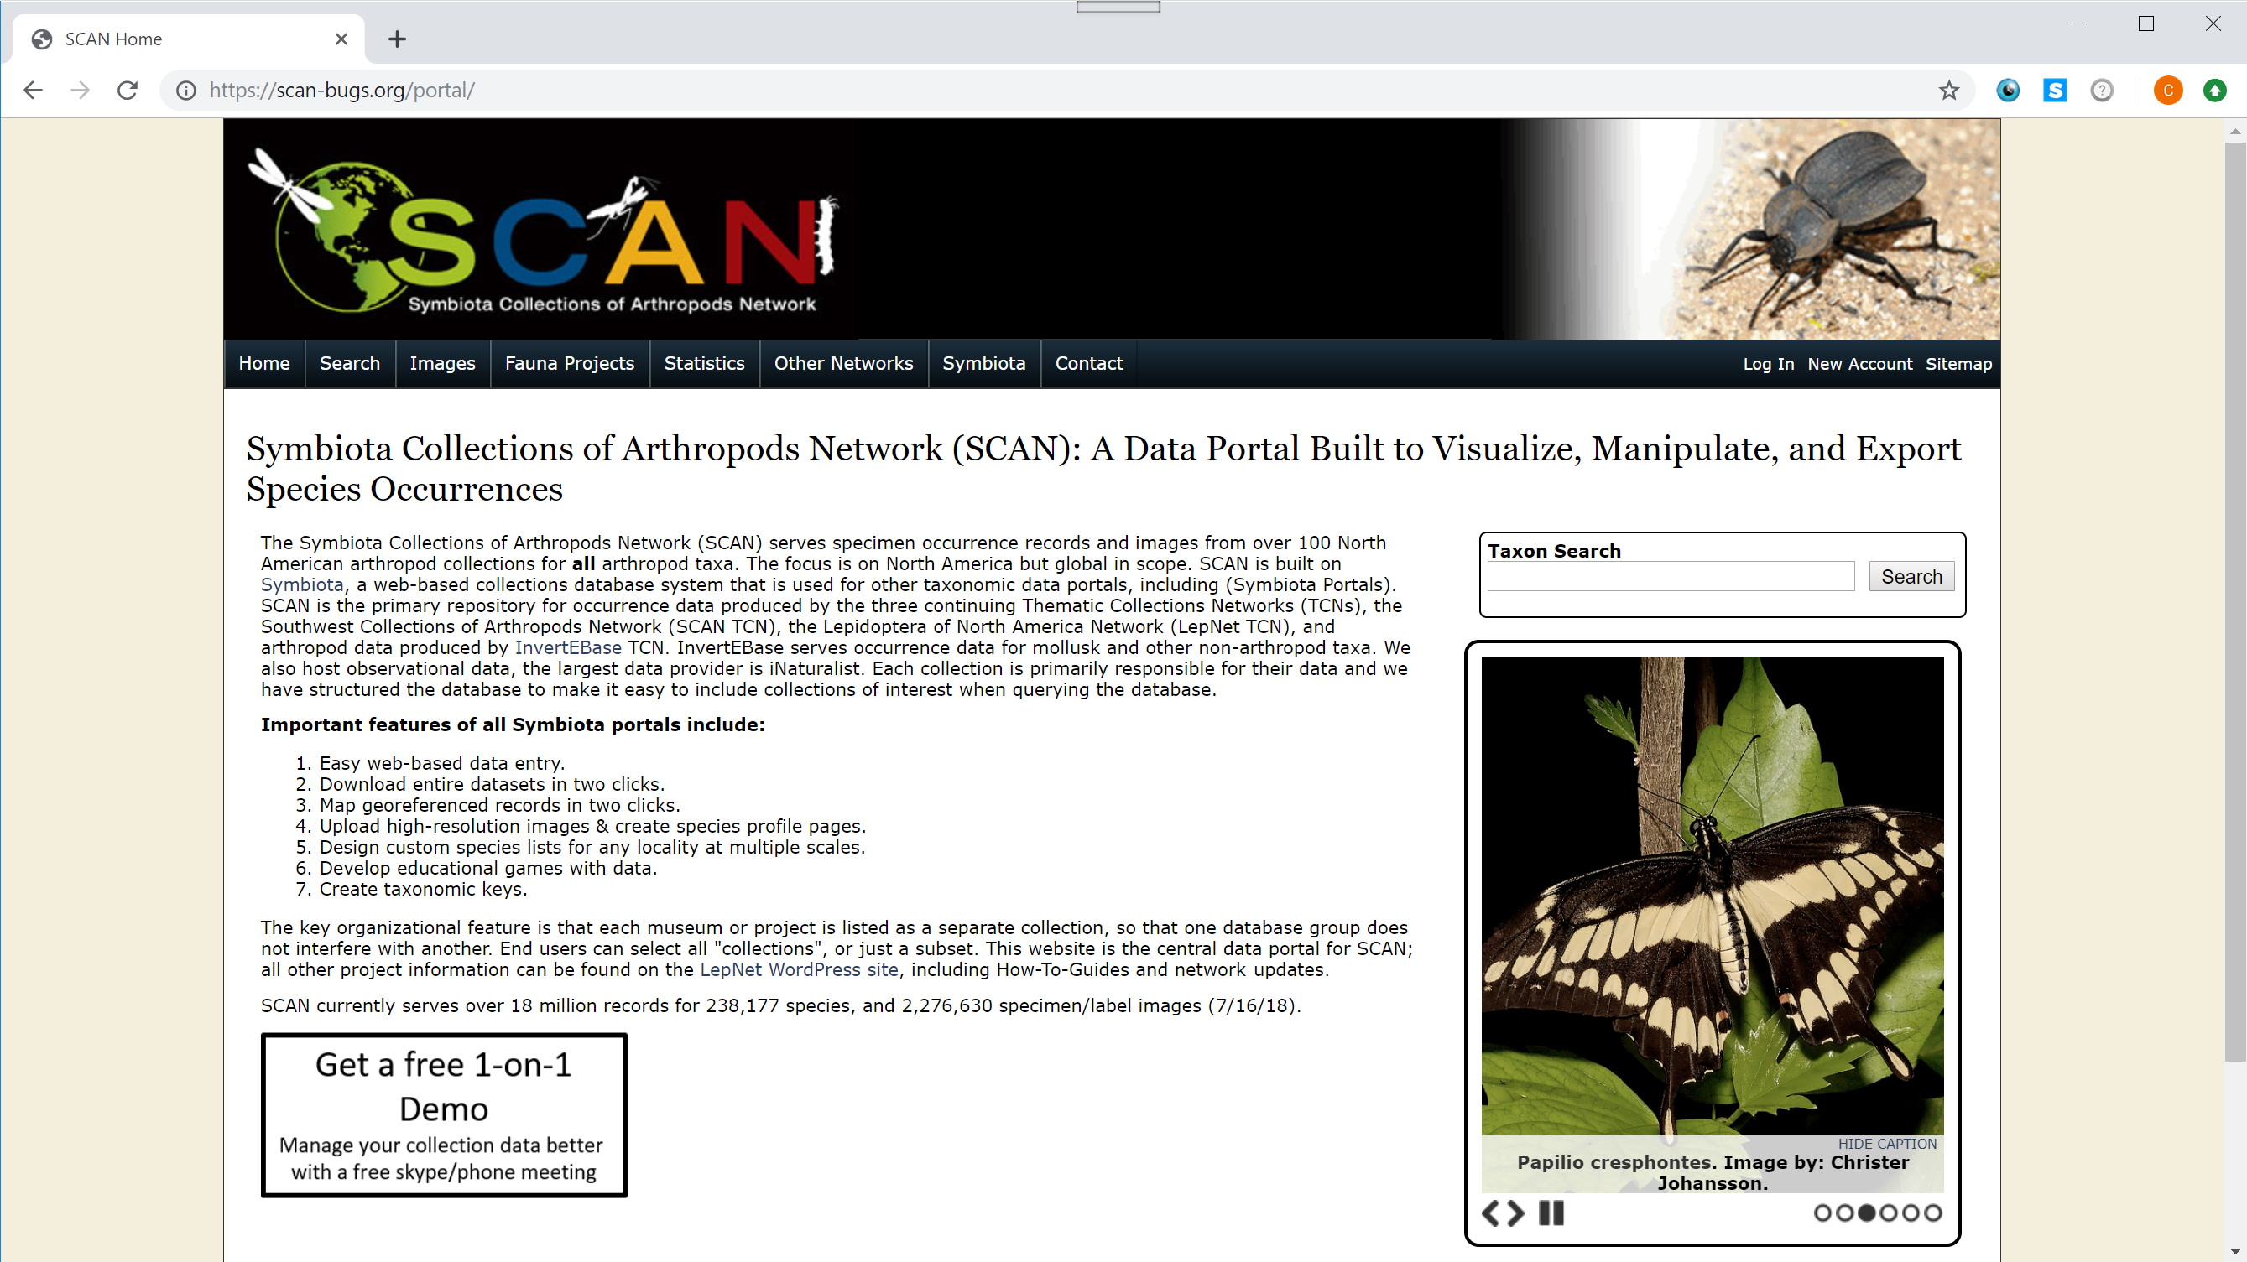

Slide 9
Getting our data into Darwin Core (DwC) format

Slide 10



Pipeline
Export all abundance records from VectorBase to CSV (every release)
Run script on CSV to transform it to DwC format
Send to SCAN to update our collection on their site
SCAN updates our data on GBIF
DwC

Slide 11
Challenges
SCAN only uses a subset of DwC terms
Useful terms like datasetID are not used
Solution: “Repurpose” a couple of their fields for our data
dataGeneralizations: meant to describe how data was potentially made less specific
VB
DwC
projects
VBP0000236
VBP0000429
VBP0000255
dataGeneralizations
VBP0000236
VBP0000429
VBP0000255

Slide 12
Challenges
Our data is atomized differently than theirs
Solution: Parse and split
VB
DwC
species
Culex
genus Aedes
Aedes aegypti
Aedes vexans vexans
Anopheles crucians complex
Anopheles gambiae sensu lato
scientificName | identificationQualifier
Culex
Aedes
Aedes aegypti
Aedes vexans vexans
Anopheles crucians | complex
Anopheles gambiae | sensu lato

Slide 13
Challenges
Our data is atomized differently than theirs
Solution: Parse and split
VB
DwC
geolocations
Collier
Kent (Rhode Island)
Essex (United Kingdom)
Marion (Iowa (United States))
locality | stateProvince | country
Collier
Kent | Rhode Island
Essex |  | United Kingdom
Marion | Iowa | United States

Slide 14
Challenges (in progress)
SCAN lists the whole collection under a single license
Set it to the strictest license VB can allow: CC-BY-NC4
Some fields we didn’t add were automatically populated
basisOfRecord: “preserved specimen”

Slide 15
Challenges (in progress)
Include or don’t include data
without GPS coordinates
collected by smart traps
Some information is not always available in our CSV export
Author information is not exported, relevant when there are no citations or tags

Slide 16
Our data on SCAN & GBIF

